Slide 1
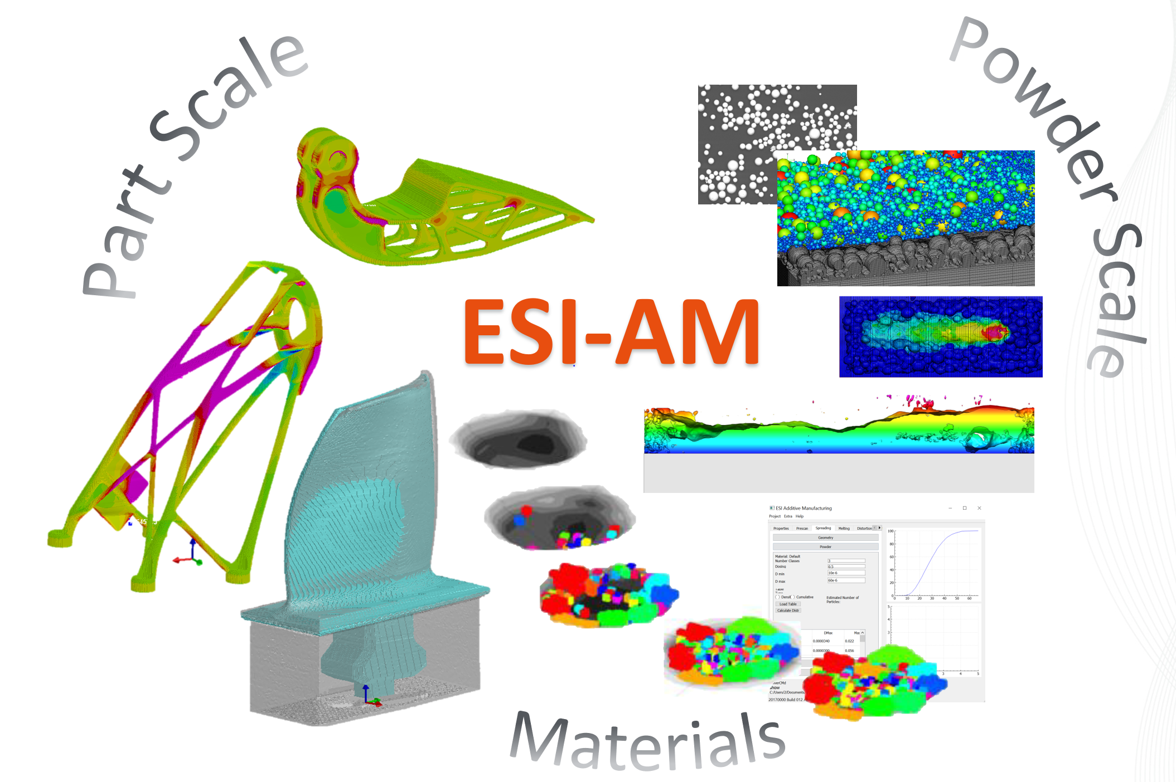
Collection of Animations for FormNext
Nov. 2018

Slide 2
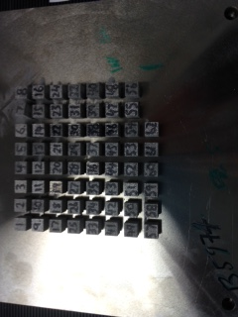

Slide 5
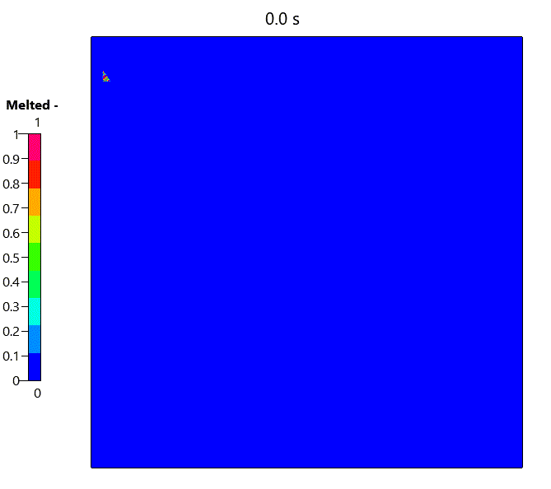
Layer n
Experimental Density Measurements

Slide 6
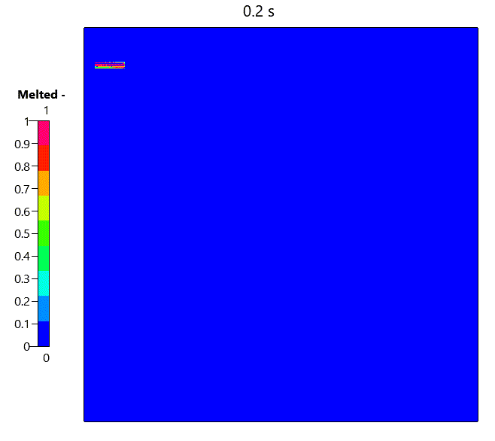
Layer m
Experimental Density Measurements

Slide 7
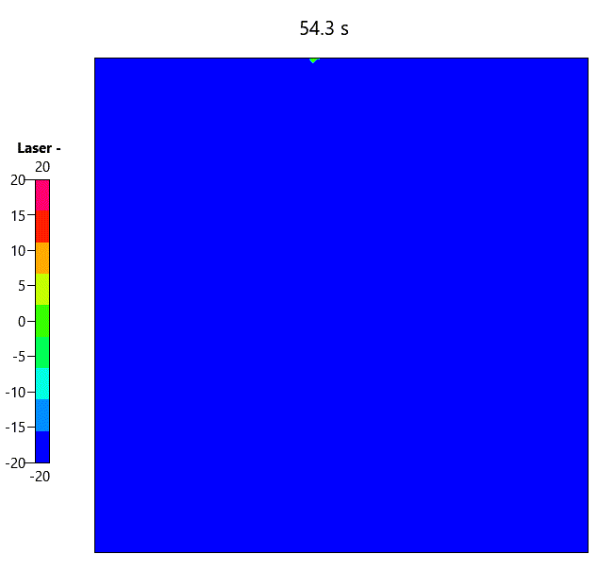

Slide 8
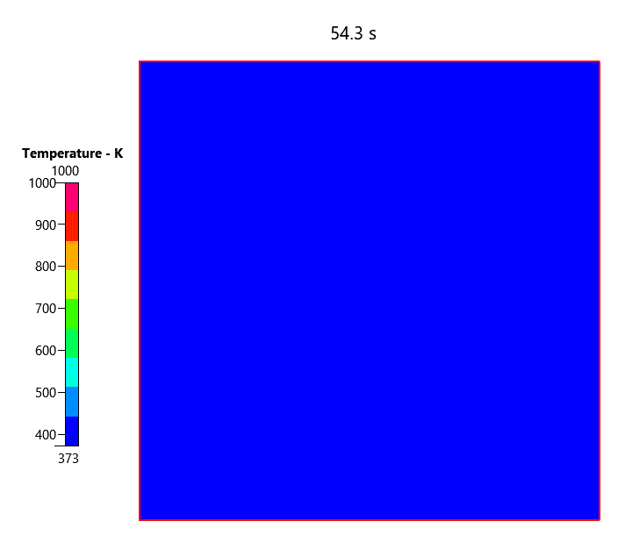
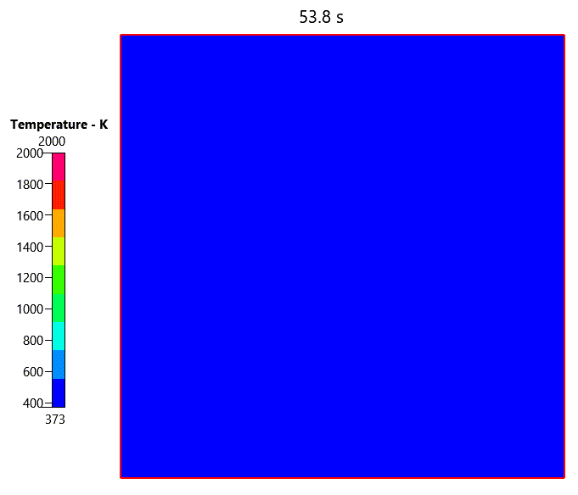

Slide 9
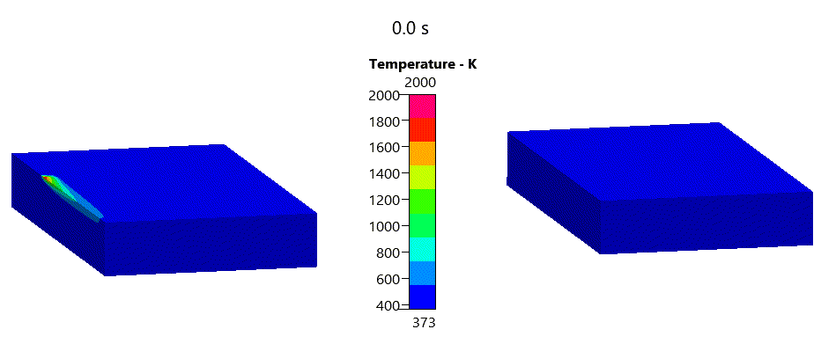
Other component: Bridge

Slide 10
ESI-AM
Thank you

